Slide 1
Multiculturalism and Cultural Competence
Psych 1A
Dr Eden Thain

Slide 2
Structure of the Module
Lecture 1
What is Cross Cultural Psychology?
Culture, Race, Ethnicity
Lecture 2
Multiculturalism
Multiculturalism, Race and Identity
Cultural Adaptation
Cultural Competence
Lecture 3
Measuring the similarities and differences between Cultures and their effects
Therapy and Mental Illness
Lecture 4
Indigenous Psychology
Role of Psychologist with Indigenous Australians
Lecture 5
Indigenous Research
Indigenous Research Ethics

Slide 3
Multiculturalism Defined
1. the quality or condition of a society in which different ethnic and cultural groups have equal status and access to power but each maintains its own identity, characteristics, and mores.
2. the promotion or celebration of cultural diversity within a society. Also called cultural pluralism. Compare cultural monism. —multicultural adj.
APA Online Dictionary
Both a state for a place / society but also a way of behaving institutionally and professionally

Slide 4
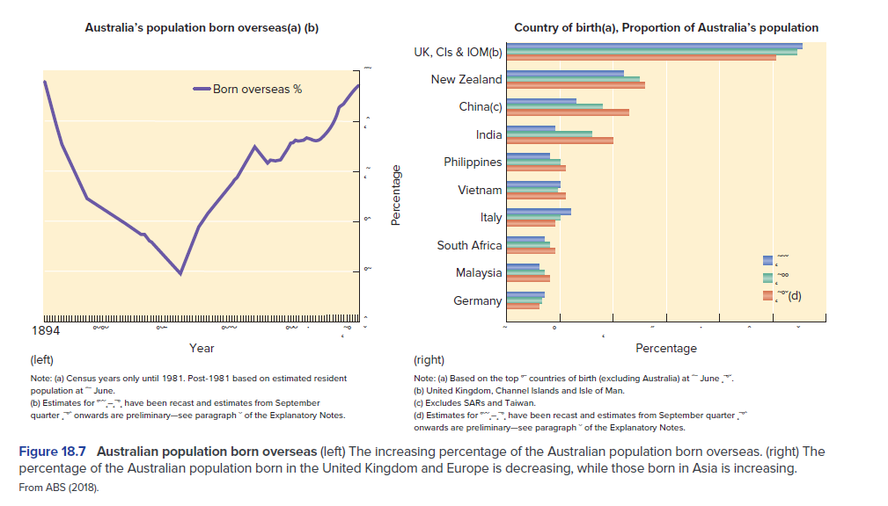
Multi-Culturalism
Australia is consistently more Multi-Cultural
Multi-culture supporting policy
History of opposition and colonization
From Passer & Smith, 2019, p. 750

Slide 5
Dimensions of the policy: Multiculturalism
Cultural Identity
The right of all Australians within carefully defined limits to express and share individual cultural heritage
Social Justice
Equality of treatment and opportunity
Economic efficiency
The need to utilize skills and talents of all, regardless of background
(National Agenda for a Multicultural Australia, 1989)

Slide 6
Past, Present and Future
European colonisation
A long history of the reduction and destruction of Indigenous and non-colonial ways of life (cultures)
A long political history of ‘white Australia’
Movement towards multiculturalism
In the 1990s
Focused on self determination and self management
Current trends
Reconciliation and mutual obligation

Slide 7


Multiculturalism, Race, and Identity
Identity is a cultural construct
Socialised from childhood
Varies across cultures
View of self E.g., Individualist versus Collectivist
Links to many other important identities
Gender
Religious Identity
Class
Sexuality
This Photo by Unknown Author is licensed under CC BY-SA
This Photo by Unknown Author is licensed under CC BY-SA

Slide 8
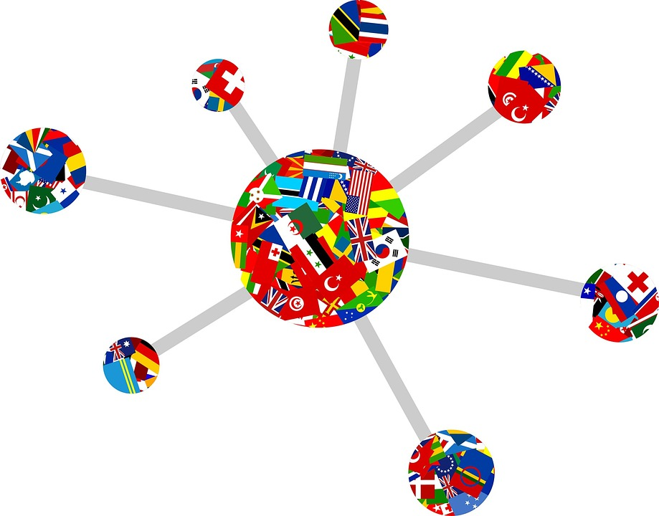
Cultural Adaption - Reflection
Movement between cultures
What happens?
What differences would you expect?
What would adaption look like?
Is it all good?

Slide 9
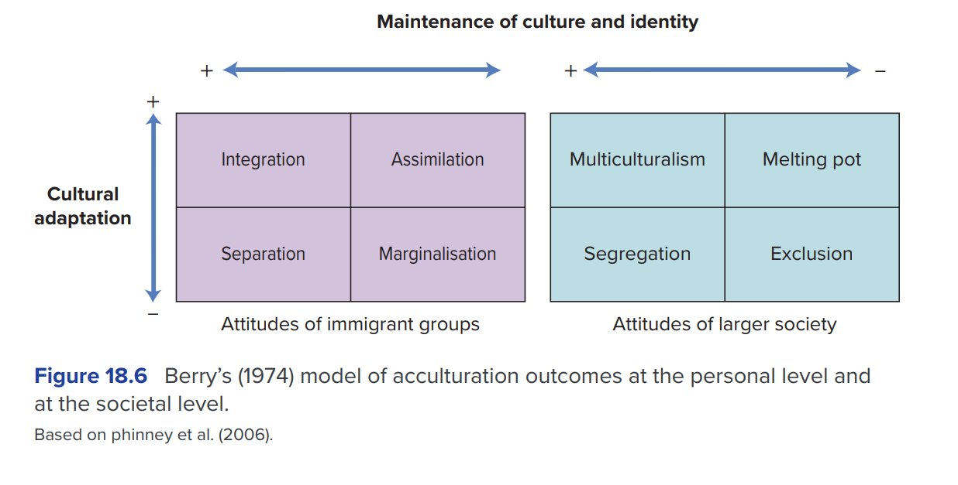
Acculturation
The processes by which groups or individuals adjust the social and cultural values, ideas, beliefs, and behavioral patterns of their culture of origin to those of a different culture.
Psychological acculturation is an individual’s attitudinal and behavioral adjustment to another culture, which typically varies with regard to degree and type.
APA Online Dictionary
From Passer & Smith, 2019, p. 747

Slide 10
Given Multiculturalism and issues in acculturation
What do we need to do as psychologists?

Slide 11
Cultural Competence
1. possession of the skills and knowledge that are appropriate for and specific to a given culture.
2. the capacity to function effectively in cultural settings other than one’s own. This usually involves a recognition of the diversity both between and within cultures, a capacity for cultural self-assessment, and a willingness to adapt personal behaviors and practices. Cultural competence has become a central concept in health care, with educators and practitioners focused on recognizing the cultural variation in clients’ health-related beliefs and activities in order to improve cross-cultural communication and health outcomes. See also cultural sensitivity.
APA Online Dictionary
Other possible terms:
Cultural Security
Cultural Awareness
Cultural Safety
Cultural Capabilities
Cultural Agility
Cultural Proficiency

Slide 12
Other Similar Terms
Cultural Security
Linking understanding to action
Cultural Awareness
Acknowledging and respecting differences
Cultural Safety
Space and practice free of assault, challenge or denial of identity and experience
Cultural Capabilities
Umbrella Term for all the above
Cultural Agility
Competent, effective, and safe movement between different context and roles cross-culturally
Cultural Proficiency
A level of skills needed to effectively work in a cross-cultural manner (sometimes with specific cultures)

Slide 13
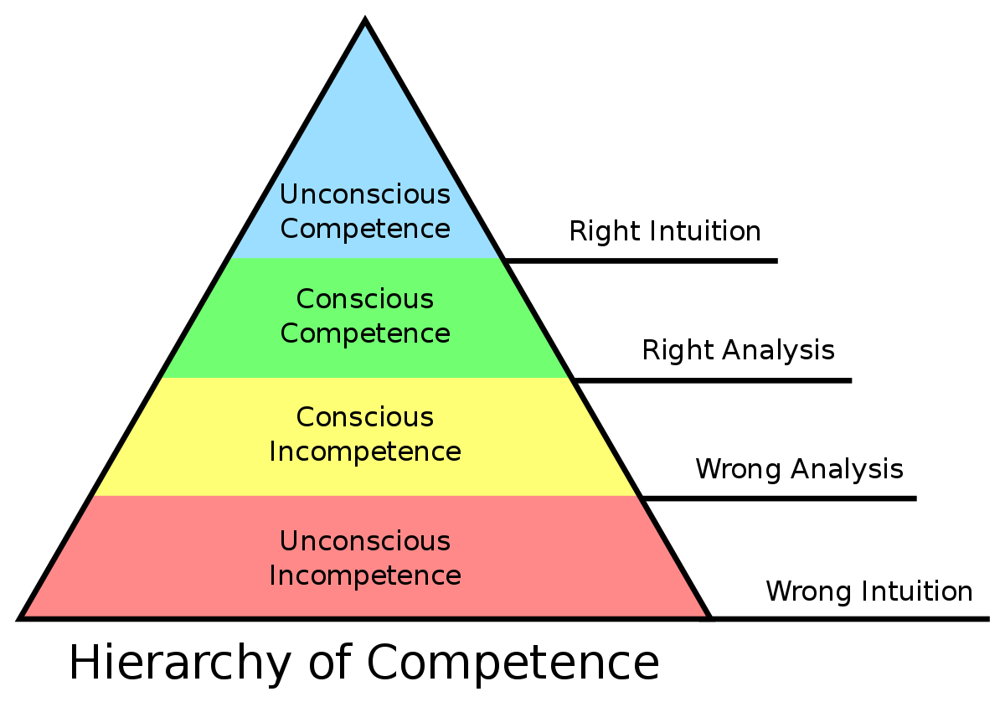
Cultural Competence
Steps of Cultural Competence
Self-Assessment
Value Diversity
Manage Diversity
Adapt to Diversity
Seek further knowledge
Often a process of critical reflection consistently and constantly to avoid bias and learn from new and different experiences
This Photo by Unknown Author is licensed under CC BY-SA

Slide 14
Steps of Cultural Competence important considerations
Different forms for different people
We all have different starting points
Cultural Destruction
Cultural Aversion/Blindness
Cultural Awareness
Cultural Sensitivity
Cultural Competence
Cultural Proficiency
(Cross et al., 1989)
Self-Reflection and Self-Awareness
A crucial first step
An ongoing journey and practice
Never really over, just as cultures never stop evolving
Proper Supervision
Needed and should always be sought out

Slide 15
Cultural Competence Examples
Difficulty in having concrete examples
Has been reduced to “Awareness, Knowledge, and Skills”
Other challenge this as limited and narrow
Competence is intertwined with general competence
Incorporates an ability of adaptation and ability to change with new and divergent information, cases, and contexts

Slide 16
Individual level (practitioner / researcher – service user / participant)
Availability and use of staff with bilingual or multilingual training to assist in communication
Awareness of different family structures (kinship)
Awareness and implementation of culturally relevant interpersonal practices (e.g., gender relations, taboo topics etc.)
Organisational level
Appropriate training to all
Equal opportunity at all levels of organisational interaction
Relevant and clear content with appropriate representation

Slide 17
Things to consider and previous criticisms
Stereotyping of groups
possible with rigid and ‘rote’ training
should not occur if reflection and awareness is facilitated with direct interaction and learning
Inadvertent segregation of treatment
Unlikely if adaptable to the needs of the population and avoid stereotyping
Overemphasis of the personal identity of individuals
Structural and interactional issues and ideas should still be present in culturally competent interactions
(Sue, et al., 2009)
Effect of culturally competent practice on individuals not being fully understood
More research is supporting practices all the time
We will develop as more research comes to light
Training on cultural competence never really ends (just like all training professionally)

Slide 18
References
American Psychological Association. (n.d). Cultural Competence. In APA dictionary of psychology. Retrieved June 2021 from https://dictionary.apa.org/cultural-competence
American Psychological Association. (n.d). Multiculturalism. In APA dictionary of psychology. Retrieved June 2021 from https://dictionary.apa.org/multiculturalism
Australia. Office of Multicultural Affairs. (1989). National Agenda for a Multicultural Australia : sharing our future. Canberra : Australian Govt. Pub. Service
Cross T., Bazron, B., Dennis, K., & Isaacs, M. (1989). Towards a Culturally Competent System of Care, Volume I. Washington, D.C.: Georgetown University Child Development Center, CASSP Technical Assistance Centre.
Passer, M. W. & Smith, R. E. (2019). Psychology – The Science of Mind and Behaviour (Australian Edition 3e). McGraw-Hill: North Ryde, NSW
Sue, S., Zane, N., Nagayama Hall, G. C., & Berger, L. K. (2009). The Case for Cultural Competency in Psychotherapeutic Interventions. Annual Review of Psychology, 60(1), 525–548. https://doi.org/10.1146/annurev.psych.60.110707.163651

